Slide 1

Penetration Testing Methodologies

Slide 2
Penetration-Testing Methodologies
White box model
Tester is told everything about the network topology and technology
Network diagram
Tester is authorized to interview IT personnel and company employees
Makes tester’s job a little easier

Slide 3
Penetration-Testing Methodologies
Black box model
Company staff does not know about the test
Tester is not given details about the network
Burden is on the tester to find these details
Tests if security personnel are able to detect an attack

Slide 4
Penetration-Testing Methodologies
Gray box model
Hybrid of the white and black box models
Company gives tester partial information

Slide 5
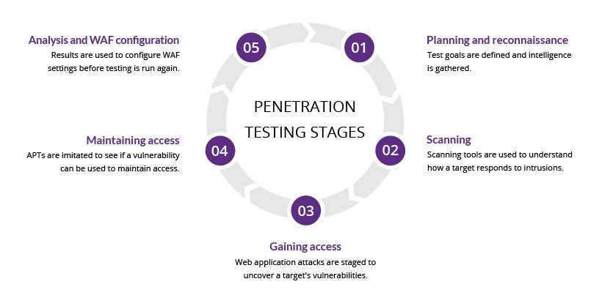
Penetration testing stages

Slide 6
1. Planning and reconnaissance
The first stage involves:
Defining the scope and goals of a test, including the systems to be addressed and the testing methods to be used.
Gathering intelligence (e.g., network and domain names, mail server) to better understand how a target works and its potential vulnerabilities.

Slide 7
2. Scanning
The next step is to understand how the target application will respond to various intrusion attempts. This is typically done using:
Static analysis – Inspecting an application’s code to estimate the way it behaves while running. These tools can scan the entirely of the code in a single pass.
Dynamic analysis – Inspecting an application’s code in a running state. This is a more practical way of scanning, as it provides a real-time view into an application’s performance.

Slide 8
3.Gaining Access
This stage uses web application attacks, such as cross-site scripting, SQL injection and backdoors, to uncover a target’s vulnerabilities.
Testers then try and exploit these vulnerabilities, typically by escalating privileges, stealing data, intercepting traffic, etc., to understand the damage they can cause.

Slide 9
4. Maintaining access
The goal of this stage is to see if the vulnerability can be used to achieve a persistent presence in the exploited system— long enough for a bad actor to gain in-depth access.
The idea is to imitate advanced persistent threats, which often remain in a system for months in order to steal an organization’s most sensitive data.

Slide 10
5. Analysis
The results of the penetration test are then compiled into a report detailing:
Specific vulnerabilities that were exploited
Sensitive data that was accessed
The amount of time the pen tester was able to remain in the system undetected
This information is analyzed by security personnel to help configure an enterprise’s Web Application Firewall (WAF) settings and other application security solutions to patch vulnerabilities and protect against future attacks.

Slide 11
Penetration Testing Methods

Slide 12
External testing
External penetration tests target the assets of a company that are visible on the internet, e.g.,
The web application itself, the company website, and email and domain name servers (DNS).
The goal is to gain access and extract valuable data.

Slide 13
Internal testing
In an internal test, a tester with access to an application behind its firewall simulates an attack by a malicious insider.
This isn’t necessarily simulating a rogue employee.
A common starting scenario can be an employee whose credentials were stolen due to a phishing attack.

Slide 14
Blind testing
In a blind test, a tester is only given the name of the enterprise that’s being targeted.
This gives security personnel a real-time look into how an actual application assault would take place.

Slide 15
Targeted testing
In this scenario, both the tester and security personnel work together and keep each other appraised of their movements.
This is a valuable training exercise that provides a security team with real-time feedback from a hacker’s point of view.

Slide 16
Thank You

